Slide 1
Android Training Program
Dealing with Platform Fragmentation

Slide 2
Platform Fragmentation
Android’s flexibility: Greatest strength and greatest weakness
Issues to deal with:
Fragmented platform versions in the wild.
Different screen sizes (aspect ratio)
Different screen densities

Slide 3
Fragmented Versions
“Chinese” devices are almost impossible to update
Updating manually is a complicated process (unlike iOS via iTunes)
OTA updates are possible, but operators and/or manufacturers don’t always hurry to push it.
RESULT => Slow adaptation of new OS versions. Older versions hang around and needs supporting.

Slide 4
Different Screen Sizes
Screen Size = aspect ratio
Phones Vs Tablets
Android defines 3 baseline screen sizes:
large screens are at least 640dp x 480dp
normal screens are at least 470dp x 320dp
small screens are at least 426dp x 320dp
Some devices only work on a landscape orientation and never portrait.

Slide 5
Different Screen Densities
Definition:
“The quantity of pixels within a physical area of the screen; usually referred to as dpi (dots per inch). E.g. a "low" density screen has fewer pixels within a given physical area, compared to a "normal" or "high" density screen.
Android defines 4 baseline screen densities: low (ldpi), medium (mdpi), high (hdpi), and extra high (xhdpi).

Slide 6
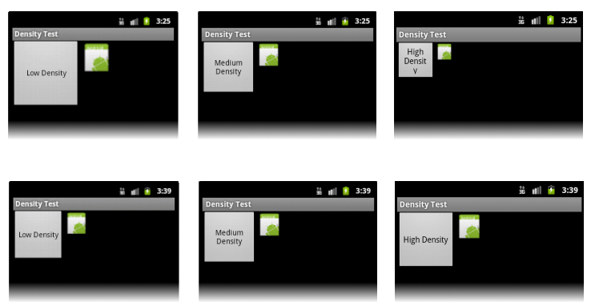
Dealing with Different Screen Sizes and Screen Densities
Use a different layout for Landscape and Portrait modes
Layout Qualifiers
Never hardcode your UI sizes using “px” (physical pixels) – they will NOT scale. Use “dp” (Device-Independent Pixels).
px = dp * (dpi / 160)
E.g. on a 240 dpi screen, 1 dp = 1.5 physical pixels
Always use different bitmap drawables for different image resources (drawable qualifers)
DO QA ON YOUR APP ON DIFFERENT SCREEN SIZES/DENSITIES!

